Slide 1
ENSE 470, Milestone 3
ByteThis Software
Taylor Petrychyn, Alwin Baby, and Konstantin Kharitonov
February 1, 2017

Slide 2
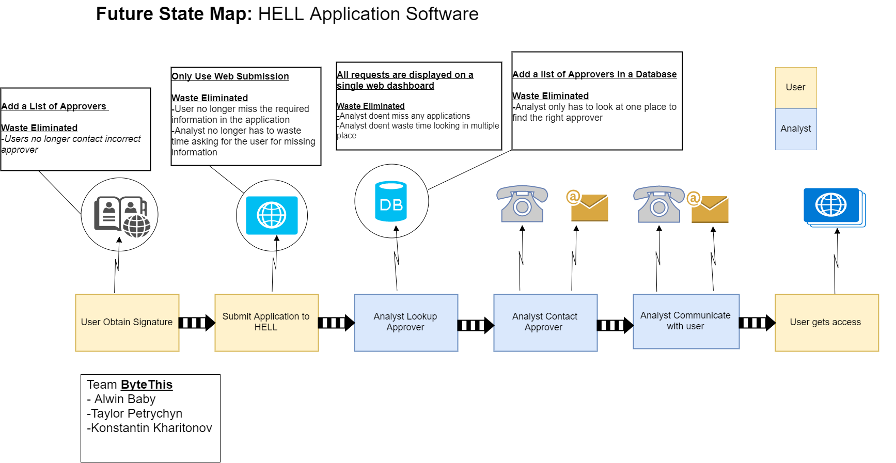

Slide 3
User Stories
As a user I would like to login to HELL so I can submit and review tickets.
As a user I would like to submit software access applications to HELL so that I can get access to the software I need.
As a user I would like to see the status of my software application tickets so that I can see roughly when I’ll get access.
As a user I would like to modify or delete my open applications so that I can fix mistaken applications.
As a user I would like to be notified when my software application has been approved/denied so that I can begin using my software/resubmit.

Slide 4
Approver Stories
As an approver I would like to login to HELL so I can review and approve tickets.
As an approver I would like to be notified when a new application needs my approval so that I can approve it.
As an approver I would like a way to view all applications pending my approval so that I can approve them.

Slide 5
Analyst Stories
As an analyst I would like to login to HELL to manage and review tickets.
As an analyst I would like to be notified when a new ticket comes in so that I can review it.
As an analyst I would like a way to view all tickets in the system so that I can review them.
As an analyst I would like a way to filter tickets in the system by status or other filters so that I can find the ticket I’m looking for.
As an analyst I would like a way to modify the current status of a ticket so that I can keep track of the state of the ticket.
As an analyst I would like a way to notify the user if there is incorrect or missing information.

Slide 6
Analyst Stories Cont’d
As an analyst I would like to add new users to HELL so they can use the system.
As an analyst I would like to modify/remove users from HELL so I can keep the system up to date with employee changes.
As an analyst I would like a way to add/remove approvers to software applications so that they can approve the software in the tickets.
As an analyst I would like to grant access to software applications so that I can give users access when tickets are approved.

Slide 7
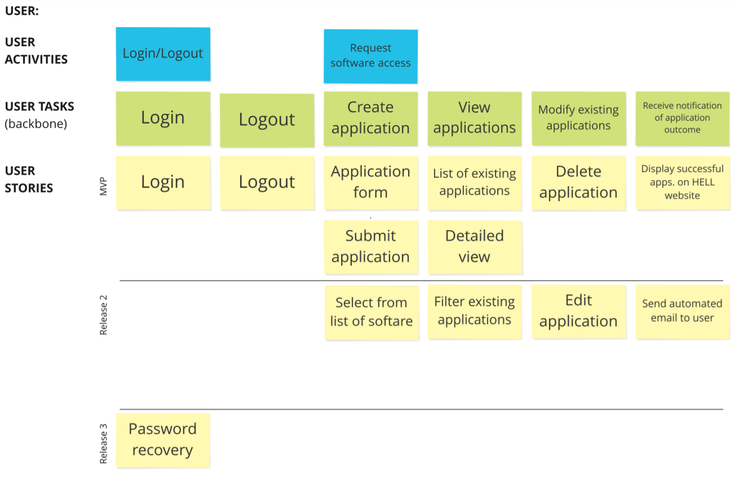

Slide 8
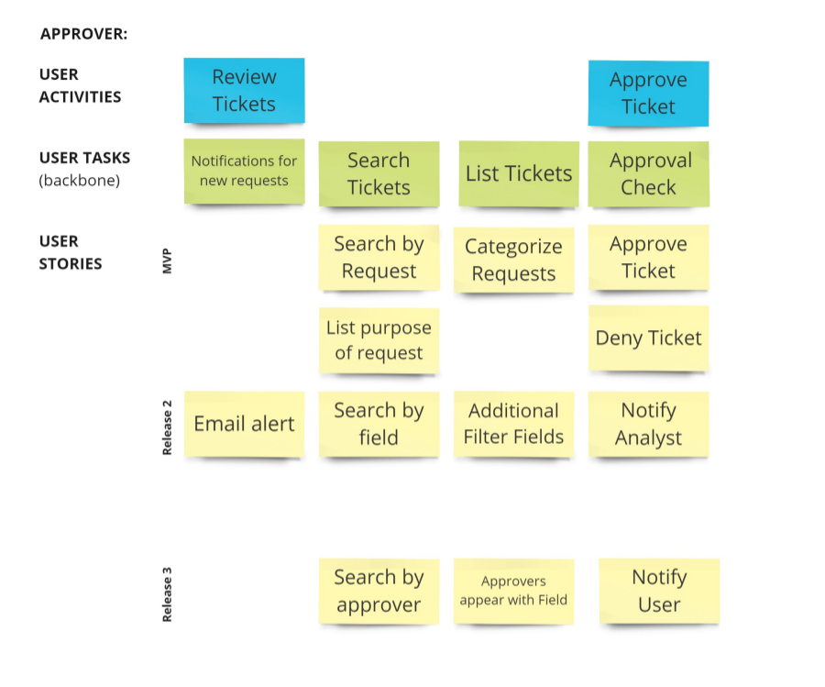

Slide 9
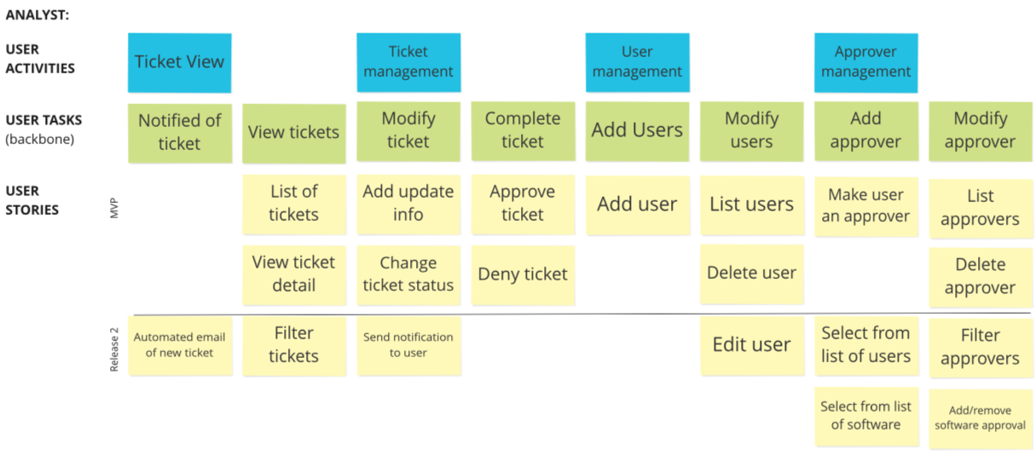

Slide 10
Changes & Misc.
Analyst looks at the application after approval.
Users application goes to approver automatically.

Slide 11
Group reflection
How did you feel about this milestone? What did you like about it? What did you dislike?
  User Story Map was something new. Drawing tool was easy to find.
What did you learn about yourself as you collaborated and worked through this milestone?
  Learned how to create User story map.
How will you use what you have learned going forward?
  Future Assignments and Planning for future Projects
What “stuff & things” related to this milestone would you want help with?
  Fine tuning the user story map

